Slide 1
Ignite Talk
GKE Autopolit

Slide 2
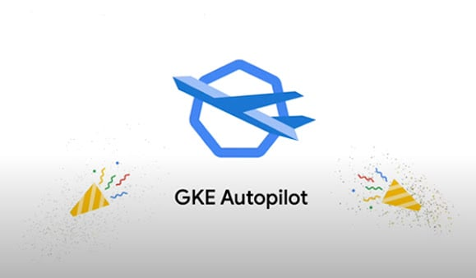
What Is Autopilot
Serverless Kubernetes
You don’t manage the Worker Nodes or any of the infrastructure components
You still manage everything after the infrastructure layer (security, networking, apps, etc.)

Slide 3

Autopilot vs Standard
Autopilot:
You don’t manage the Control Planes or Worker Nodes
Standard:
You manage the Worker Nodes (not the Control Planes)

Slide 4
Considerations
Lose customization ability
Certain third-party tools won’t work on Serverless Kubernetes

